Slide 1
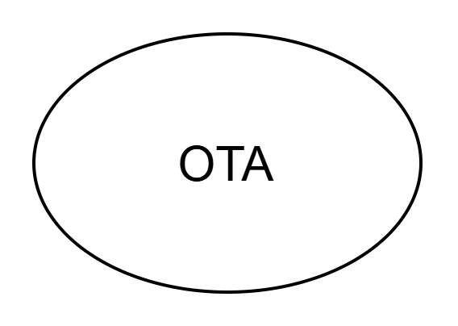


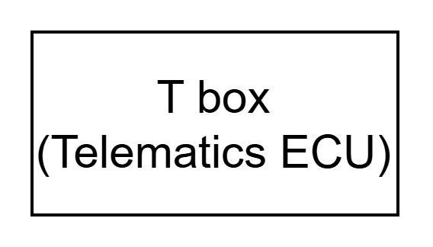
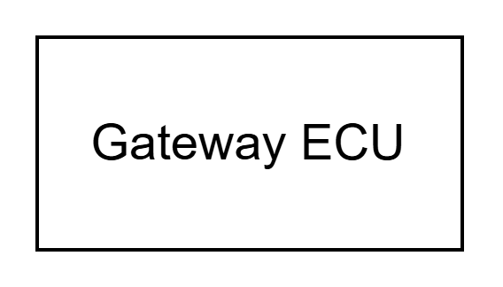



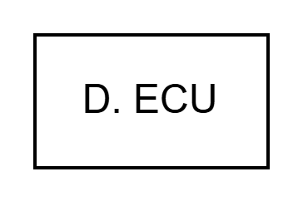
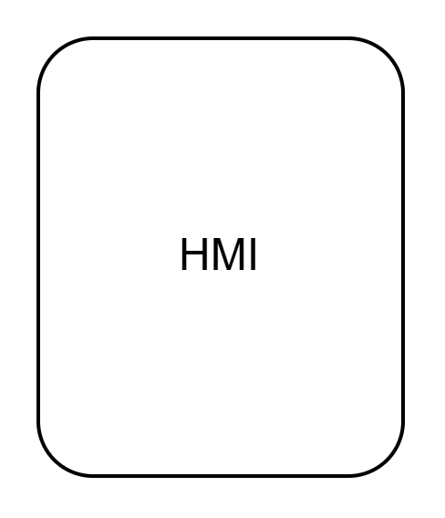
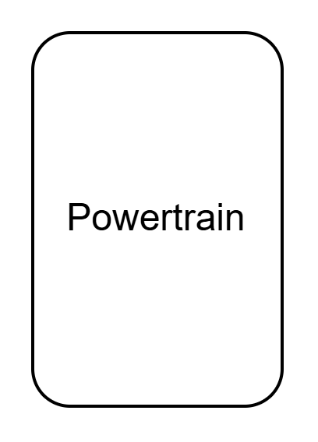
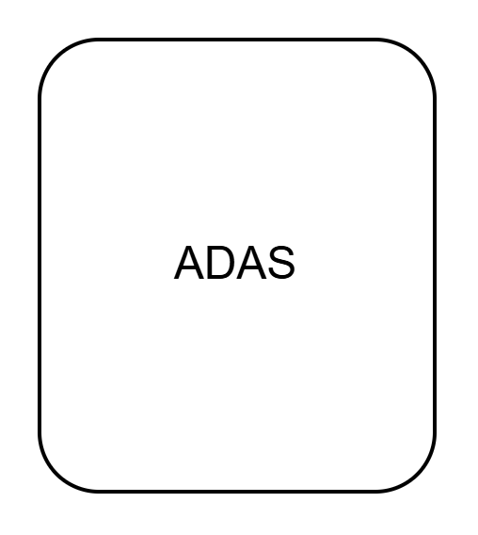

Slide 2
Asset | Asset Type | Why It’s Critical (Reason for Protection)
Software Image / Firmware | Data | Must be authentic, untampered, and verified before install
OBD-II Interface | Physical/Interface | Can be physically accessed and used to inject malicious updates
OTA Communication Channel | Interface (Wireless) | Vulnerable to MITM (man-in-the-middle), spoofing, etc.
TRM (Telematics Remote Module) | ECU | Receives OTA updates and pushes to VCU or ECU
Update Process Logic (Bootloader / Flash Manager) | Function | If compromised, attacker can brick ECU or flash malicious firmware
Vehicle ECUs (e.g., BCM, ADAS) | Hardware | Final target of update — if hacked, safety-critical systems can be compromised
Private Keys / Certificates | Cryptographic Asset | Used to verify authenticity of software (needs secure storage)
User Consent Logic / HMI Update Interface | Function/UI | Ensures updates happen with driver approval and awareness
Backend Update Server | External System | Source of update; if compromised, all connected vehicles are at risk

